Slide 1
Modelling Atmospheric Chemistry Transport With WRF GEOS-Chem
Lucas Prates, Dylan Jones, Jinwoong Kim, Zixuan Xiao

Slide 2
Background

Slide 3
Atmospheric Chemistry Transport Models
Atmospheric chemistry transport models simulate the time evolution of atmospheric constituents (trace gasses and particulate matter)
Offline models use archived meteorological fields to drive chemical transport
Online models compute the meteorological variables alongside the chemical variables

Slide 4
Online Models
Online models can simulate atmospheric chemistry at any time and place
Online models are not limited by the resolution of available meteorological data
WRF-GC is an online atmospheric chemistry transport model, which couples the Weather Researching and Forecasting Model (WRF) with GEOS-Chem

Slide 5
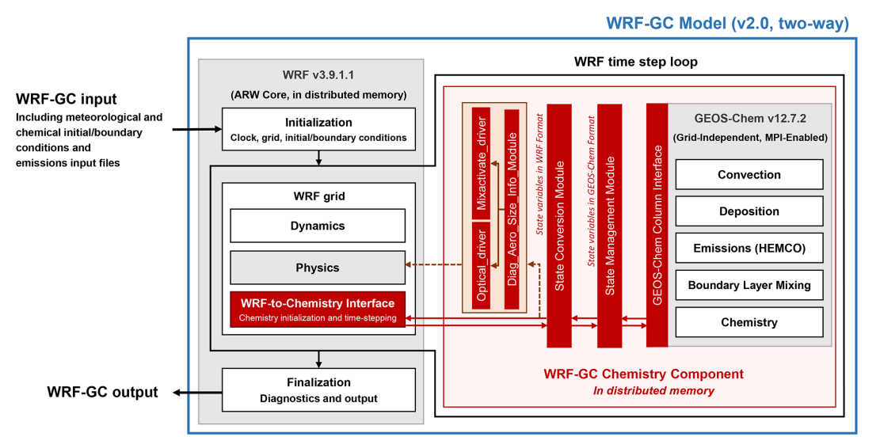
WRF-GC’s Coupler
Schematic from Feng et al. (2021)
Makes use of WRF’s grid system - input and output is in WRF format
WRF’s dynamical solver generates meteorological fields
These fields are used to drive the GEOS-Chem’s chemical processes

Slide 6
Motivation

Slide 7
NASA’S TEMPO
Figure courtesy of Xiong Liu.
TEMPO will collect hourly data for O3 and NO2 concentrations in North America
The long-term goal is to run WRF-GC at a resolution comparable to TEMPO’s and assimilate the output with TEMPO’s observations
The assimilated data will then be used to study Toronto air quality

Slide 8
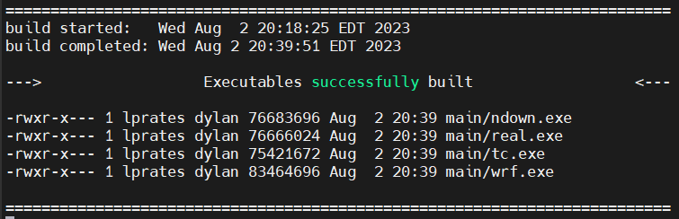
My Goals
Get WRF-GC compiled and running on Niagara
Identify what problems we may encounter while running WRF-GC
Determine how WRF’s dynamics impact GEOS-Chem’s tracer distribution

Slide 9
Methodology

Slide 10
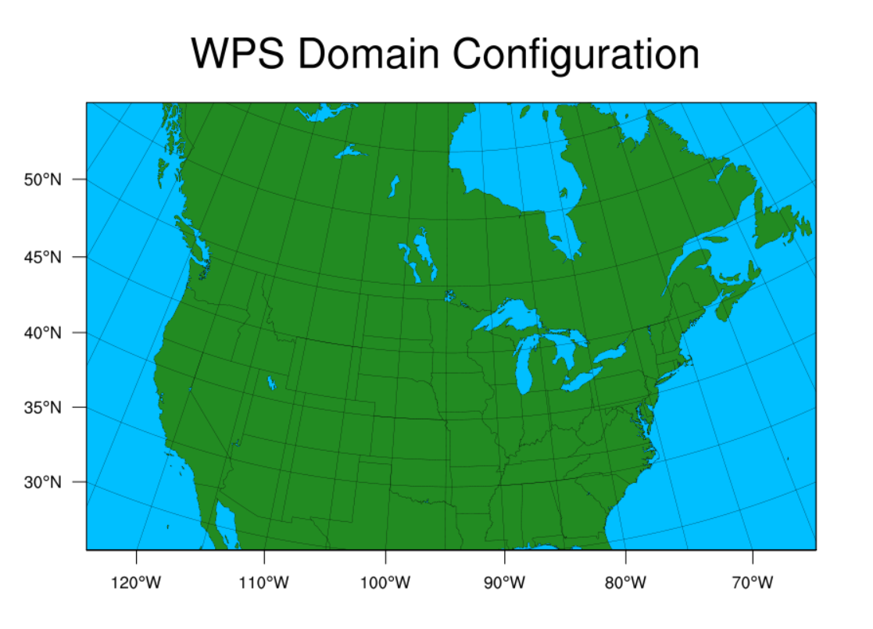
Domain Configuration
27km x 27 km resolution
40 pressure levels
10-day simulation January 1, 2018, to January 10, 2018
In the winter, differences between WRF-GC and GEOS-Chem tracer distributions will be predominantly driven by differences in dynamics
Low solar energy in the winter minimizes loss and production of chemical species

Slide 11
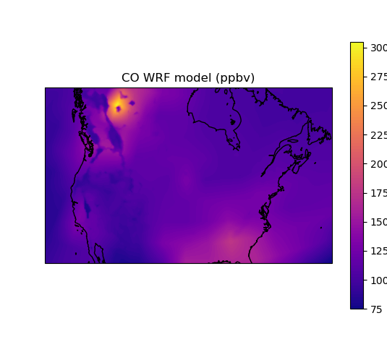
Initial and Boundary Conditions
Meteorological IC/BCs provided by archived NARR fields
Chemical IC/BCs from 4º x 5º global GEOS-Chem run
This run had a 2 month “spin-up” time
This is an additional 2 months of running required to resolve any unphysical structures present in the initial state

Slide 12
Results

Slide 13
Chemistry Evaluation
To evaluate the chemistry, I compared the output from both the 4º x 5º GEOS-Chem run and WRF-GC to surface observations from the National Air Pollution Surveillance program (NAPS)
We looked at CO, O3, and NO2 fields

Slide 14
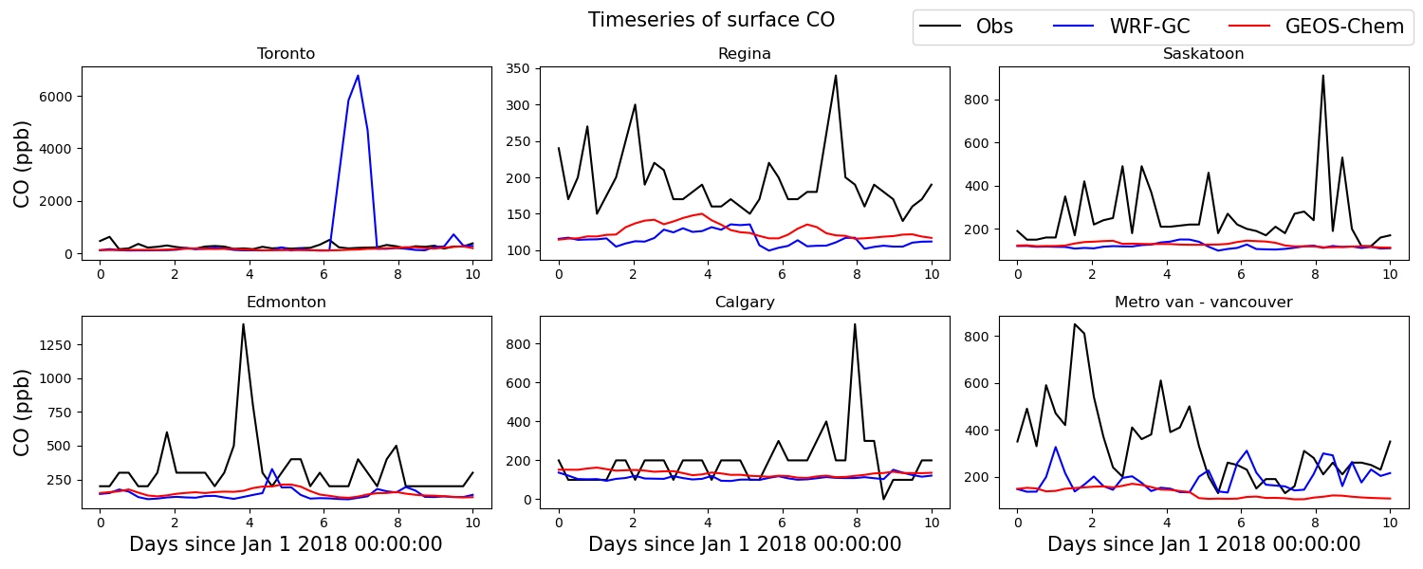

Slide 15
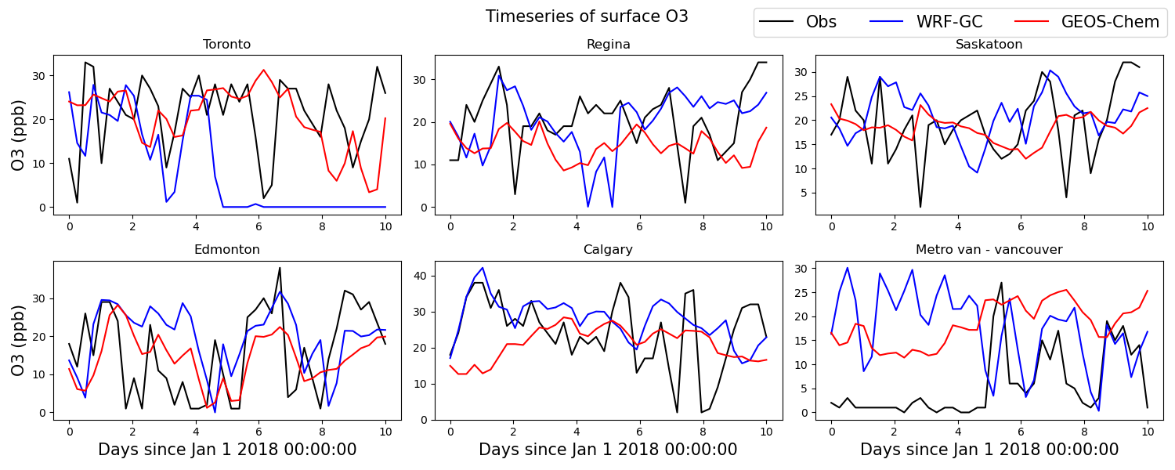

Slide 16
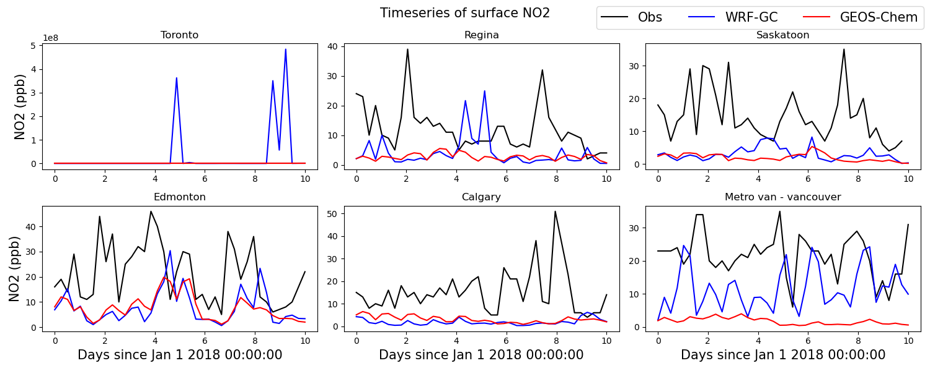

Slide 17
Meteorology Evaluation
GEOS-Chem and WRF-GC both underestimate CO and NO2 across the sampled locations
Unphysical behaviour on the east coast
To evaluate WRF’s met fields, I compared them to surface observation data from NCEP in Toronto

Slide 18
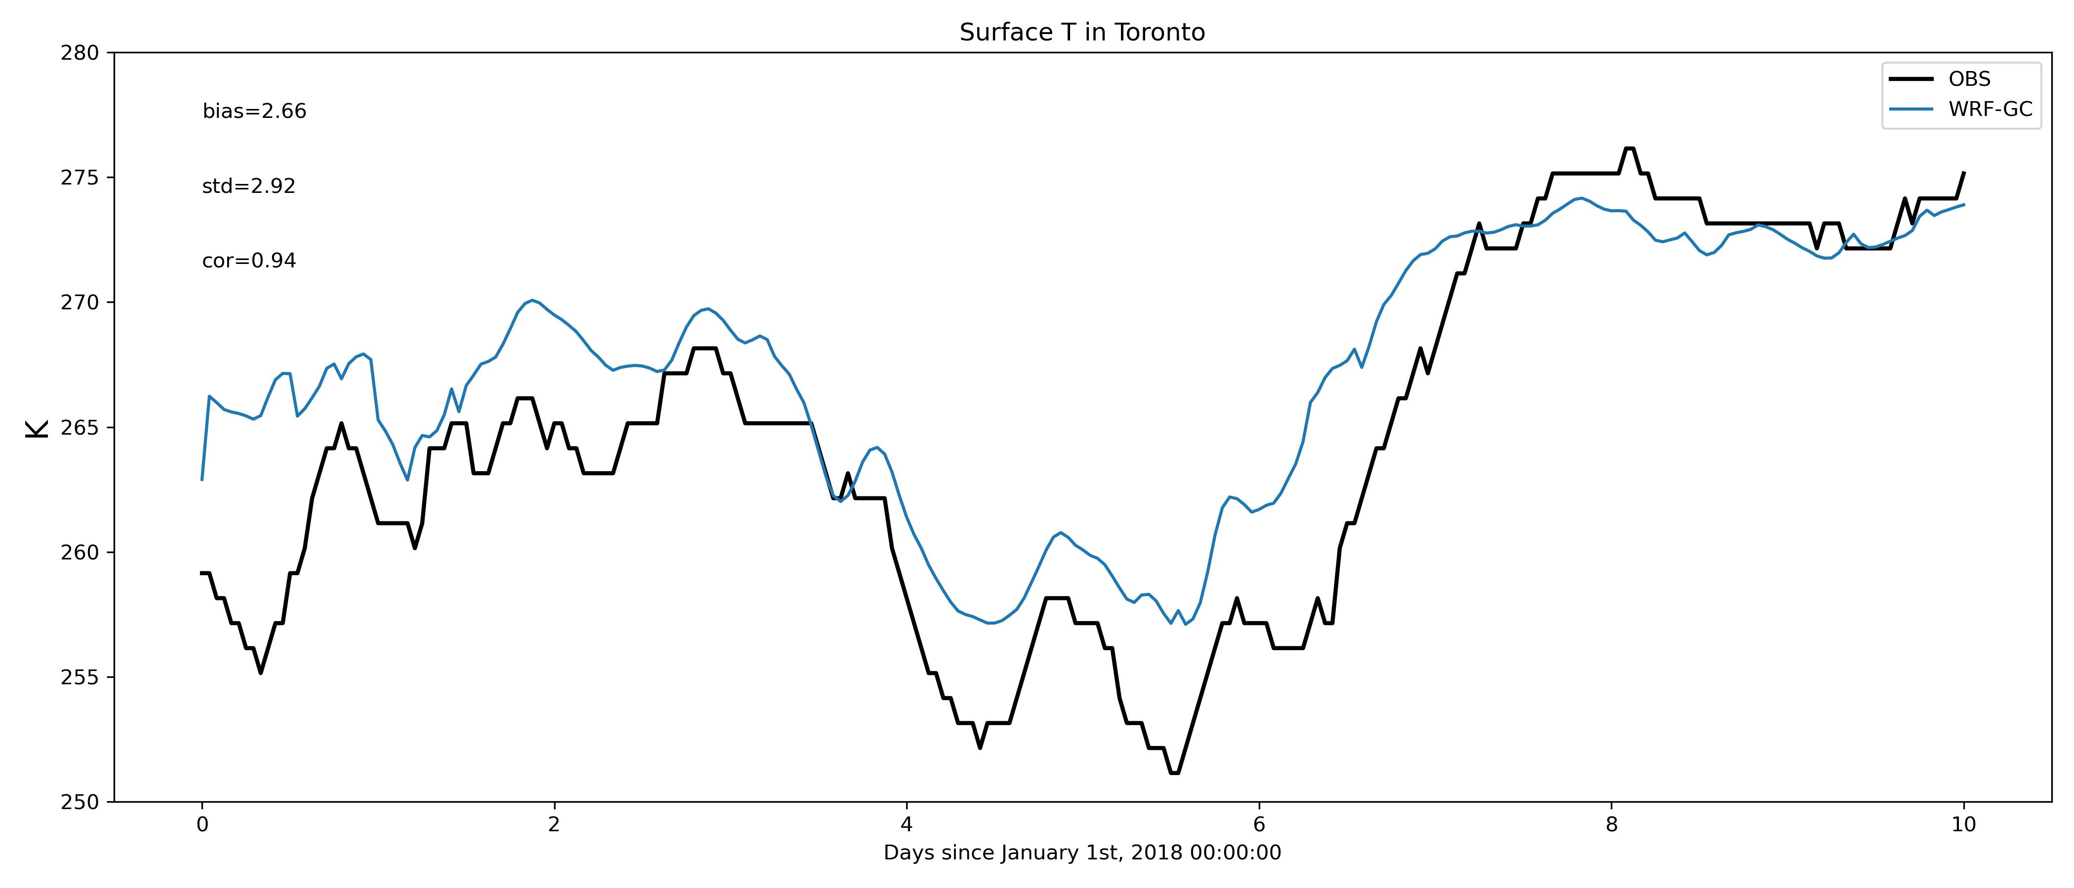

Slide 19
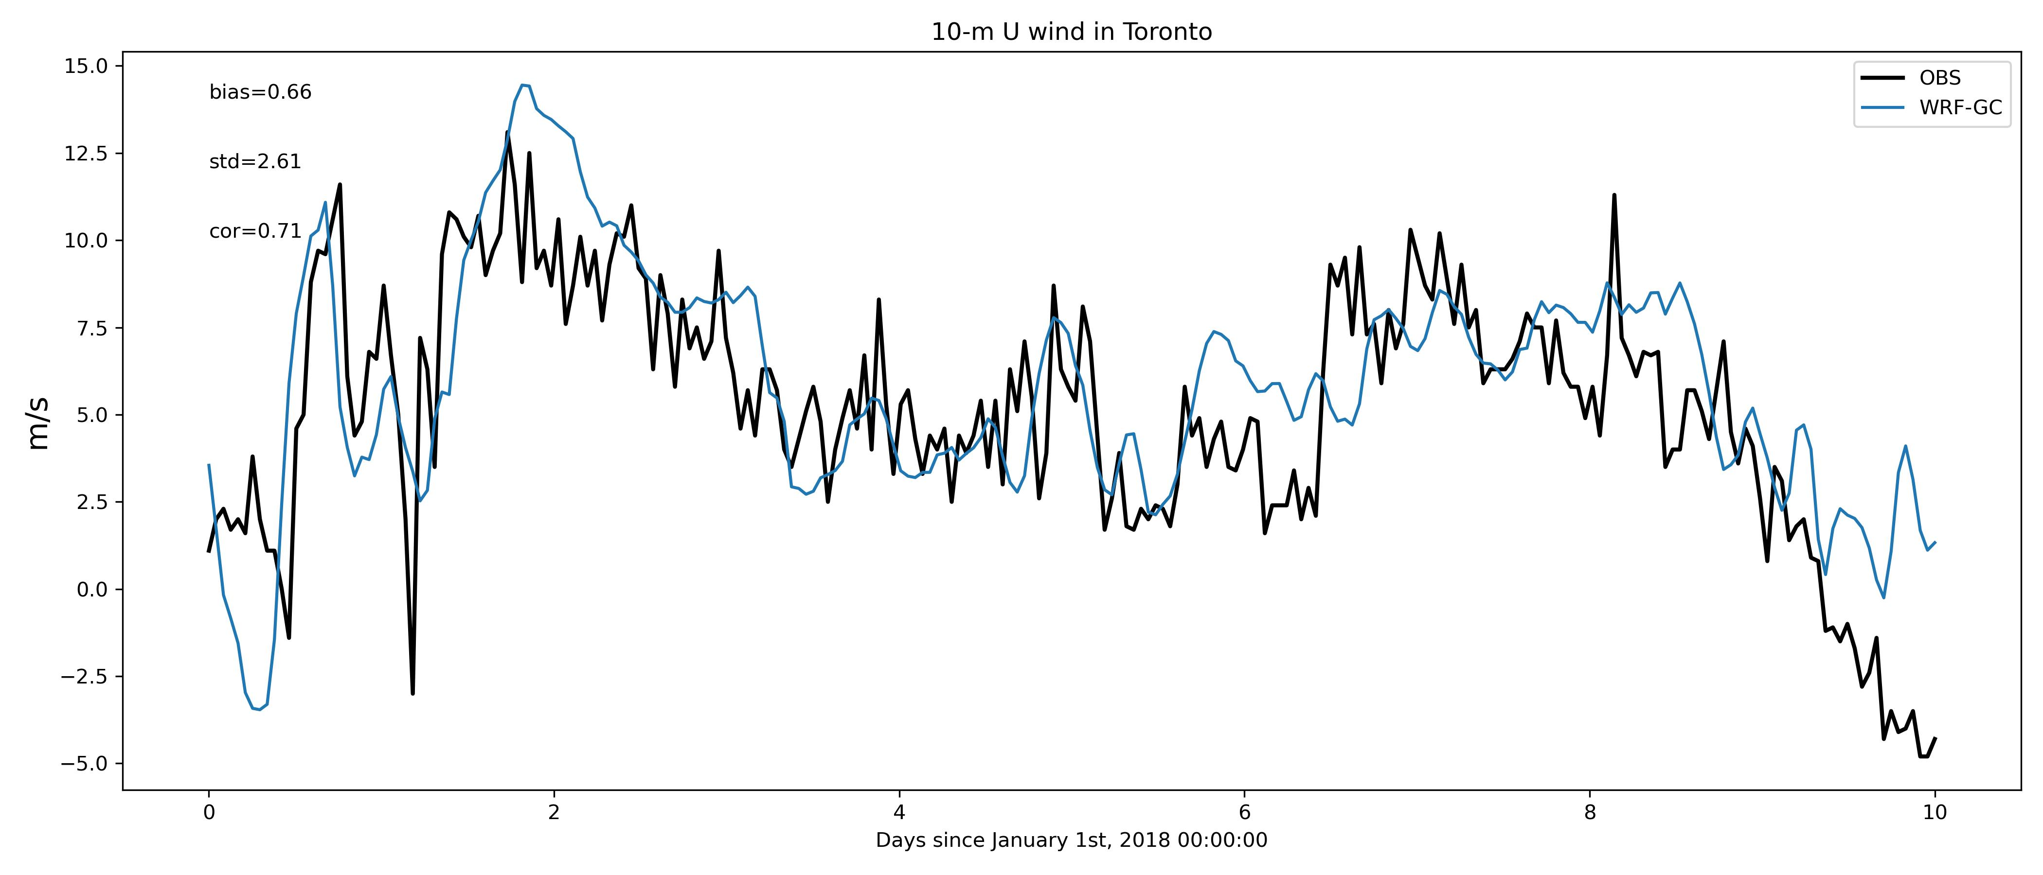

Slide 20
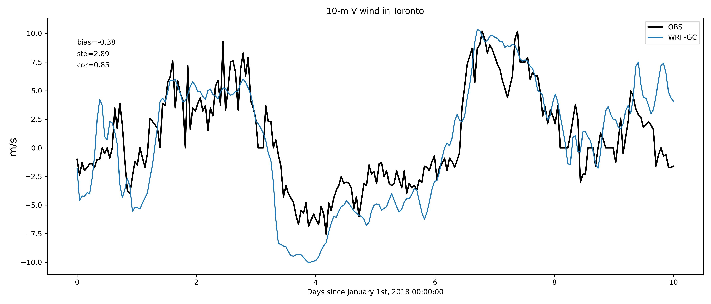

Slide 21
Conclusions
While WRF’s meteorology is consistent with NCEP data, there is an issue with the interaction between WRF’s dynamics and GEOS-Chem’s chemistry in eastern Canada
GEOS-Chem’s 2 month spin up time may be insufficient to resolve the initial state’s unphysical structures in the winter, since chemical lifetimes are longer
This would explain why both WRF-GC and GEOS-Chem underestimate CO and NO2

Slide 22
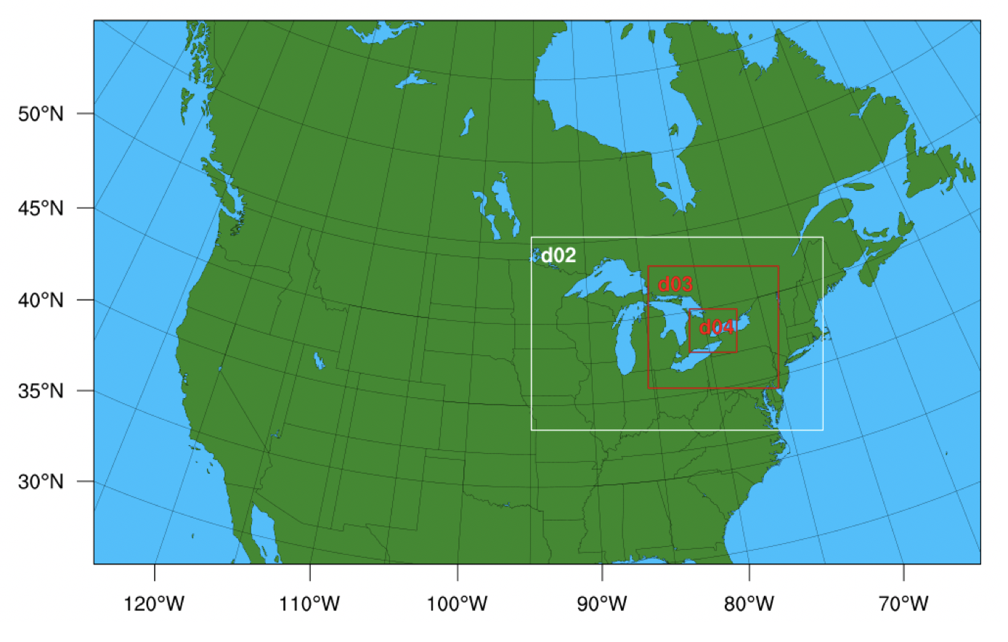
Future Work
Increase the spin-up time to 4 months
Increase the resolution of chemical IC/BCs to 2º x 2.5º
Use WRF’s domain nesting feature to increase the resolution of the model in Toronto down to 1km x 1km for air quality studies

Slide 23
References
Feng, X., Lin, H., Fu, T.-M., Sulprizio, M. P., Zhuang, J., Jacob, D. J., Tian, H., Ma, Y., Zhang, L., Wang, X., Chen, Q., and Han, Z.: WRF-GC (v2.0): online two-way coupling of WRF (v3.9.1.1) and GEOS-Chem (v12.7.2) for modeling regional atmospheric chemistry–meteorology interactions, Geosci. Model Dev., 14, 3741–3768, https://doi.org/10.5194/gmd-14-3741-2021, 2021.
National Centers for Environmental Prediction/National Weather Service/NOAA/U.S. Department of Commerce. 2005, updated monthly. NCEP North American Regional Reanalysis (NARR). Research Data Archive at the National Center for Atmospheric Research, Computational and Information Systems Laboratory. https://rda.ucar.edu/datasets/ds608.0/.5.
Environment and Climate Change Canada. National Air Pollution Surveillance Program (NAPS) – Hourly Air Quality Data. https://data.ec.gc.ca/data/air/monitor/national-air-pollution-surveillance-naps-program/Data-Donnees/2018/ContinuousData-DonneesContinu/HourlyData-DonneesHoraires/?lang=en.

